Slide 1


2025 Industry Summit
Succession & Career Progression
Kayla Holloway
Jose M Leon. Jr

Slide 2

Question
What do you hope to come away with during your time today?
When you hear succession planning what does that mean to you?
How will your organization function when you are gone?
Notes:
Group wanted to understand distinction between these.
Clarify definitions for organization as we move forward.

Slide 3

Definitions
The Vision – HPO
Succession
Organization Oriented
Focus Operational Talent
Legacy
Progression
Staff Oriented
Focus Strategic Staff Development
Feeds Succession
Top Performer
Above Average Performer
Average Performer
Below Average Performer

Slide 4

Importance and Relevance:
Only 35% of companies have formal succession plans, leaving many vulnerable to leadership gaps.
Organizations with succession plans experience a 30% higher leadership retention rate, fostering loyalty and engagement.
60% of companies with strong succession plans outperform competitors due to better strategic execution.
67% of AEC firms cite talent acquisition and retention as one of their top three challenges—more pressing than economic uncertainty or competition.
The average age of employees in the AEC sector is 41 years, indicating a generational shift and the need for leadership development.
53% of firms rate themselves as “fair” or “poor” at defining formal career paths, which directly impacts retention and employee engagement.
The industry is projected to see 186,500 job openings annually from 2024 to 2034, driven by growth and the need to replace retiring professionals.
financially significant
Notes:
Group wanted to understand distinction between these.
Clarify definitions for organization as we move forward.

Slide 5



Succession & Progression Focus
Succession – Role Focused
Progression – People & Development Focused
Succession & Progression – Ongoing Process
Notes:
Group wanted to understand distinction between these.
Clarify definitions for organization as we move forward.

Slide 6
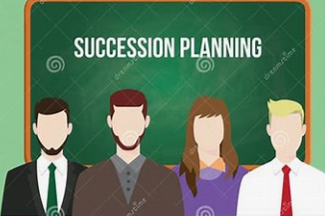


Succession Planning
Process of creating a talent pipeline
Ensure continuity of operations, performance, & agility
Identifying critical roles

Slide 7
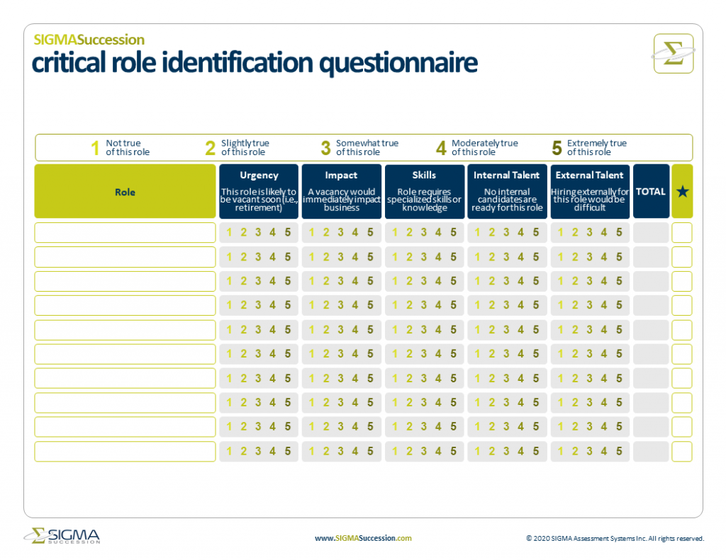
Succession Planning Framework & Tool
Committee recommendation is the SIGMA’s Succession Planning Guide.
  Straightforward & Flexible for all Depts
  Tool to replenish existing talent
  Pillars of Performance Tie-In
Planning Guide Focus
Identify Critical Roles
Build Success Profiles
Nominate Successors
Assess Development Needs
Develop Talent
Measure Progress

Slide 8

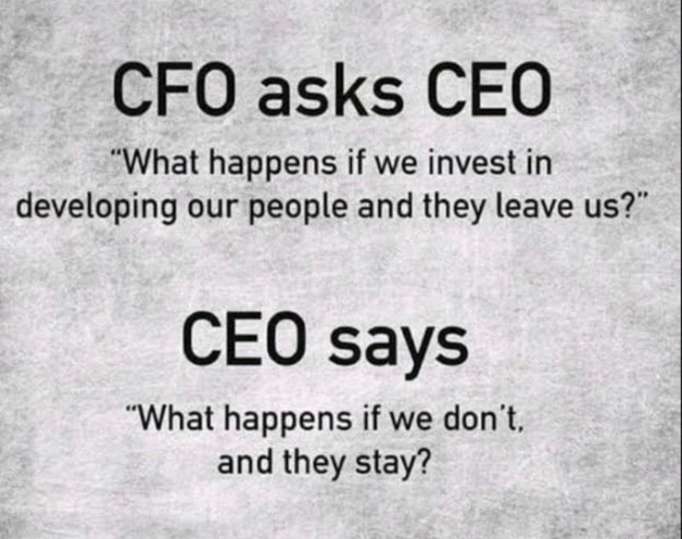
Progression Plan Process
Identification of Progression Criteria
Review & Approval of Progression Plan
Other Recommendations
* During the Progression Evaluation, engage a 3rd-party or another supervisor for non-bias input.
Continuous review
Job Evaluation Questionnaire
* Establish a scoring matrix to evaluate the established criteria.
* Tie Progression Elements to merit, org values

Slide 9
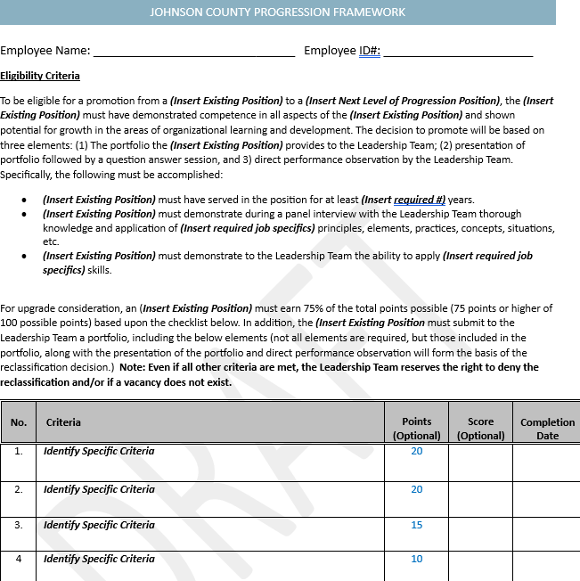
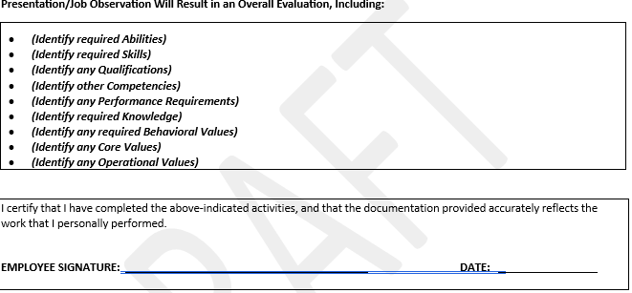
Progression Framework
Framework Focus
Identify Employee
Progression Elements
  Progression Portfolio
  Presentation of accomplishments
  Leadership Feedback
Framework requires identification of:
  Required Accomplishments
  Specific Criteria Requirements
  Identification of Presentation/Job Observation for overall evaluation
Employee’s, Manager’s & Supervisor's Completion Certification and Comments.

Slide 10
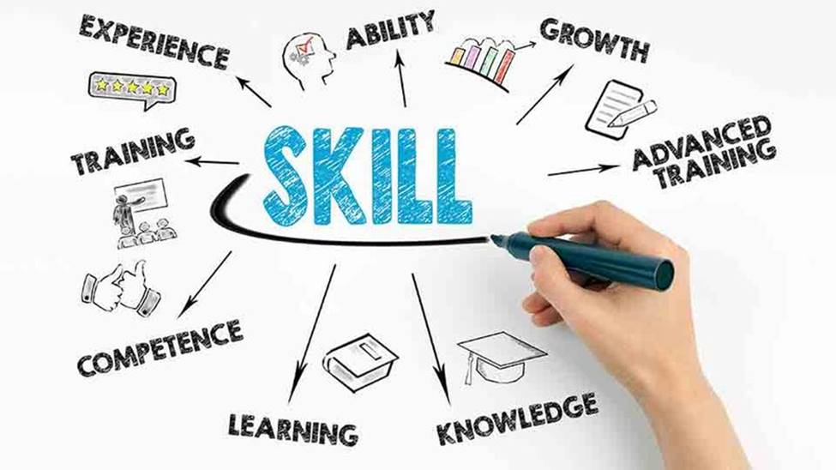

Career Progression Framework
Proactive & Prepared for right time
Employee Recruitment
Employee Retention
Preparation for Future
Adaptable/Flexible
Cost is paid, no matter what!
Specific
Focus
Personal Growth & Development
Professional Growth & Development
Leadership Growth & Development

Slide 11
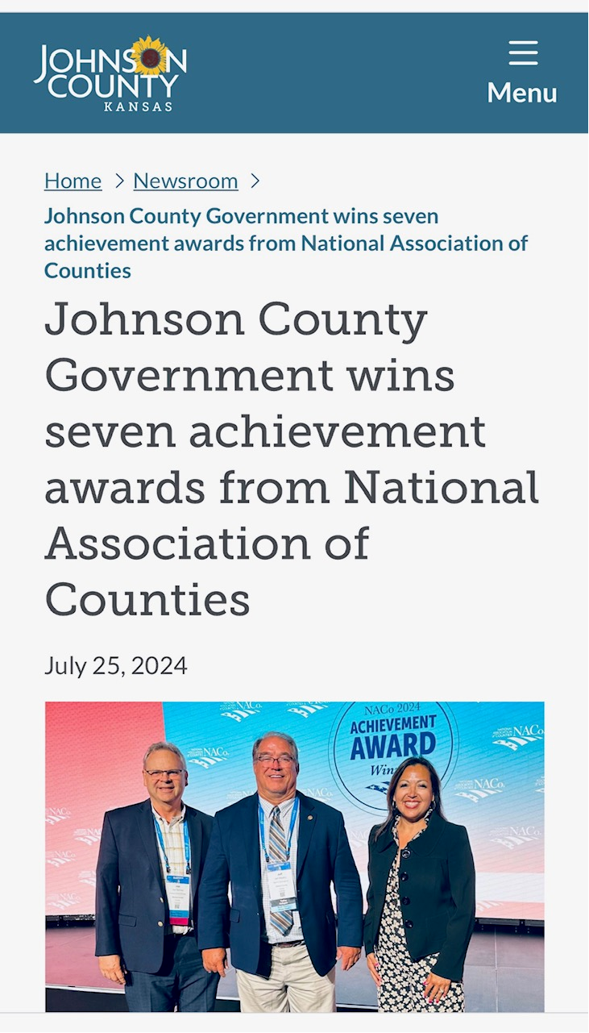
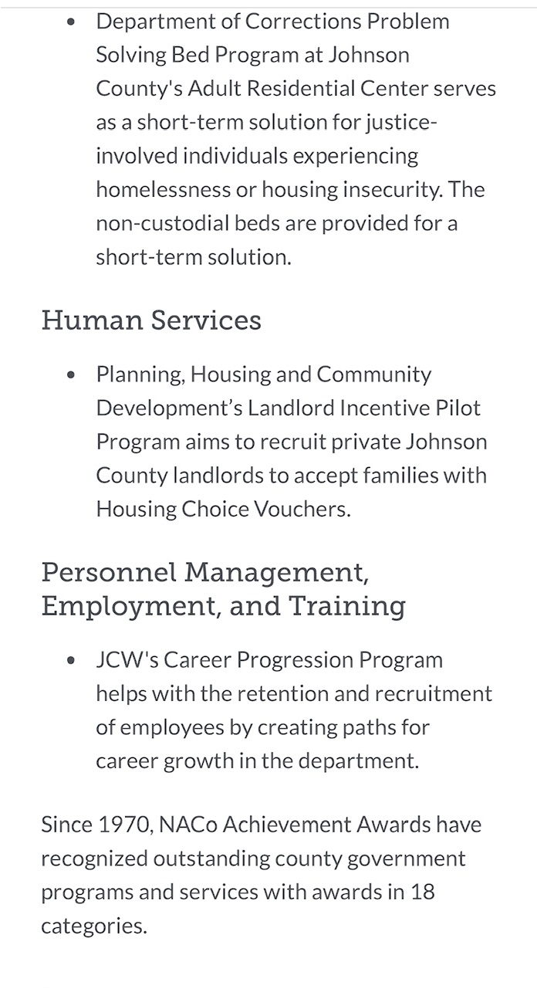
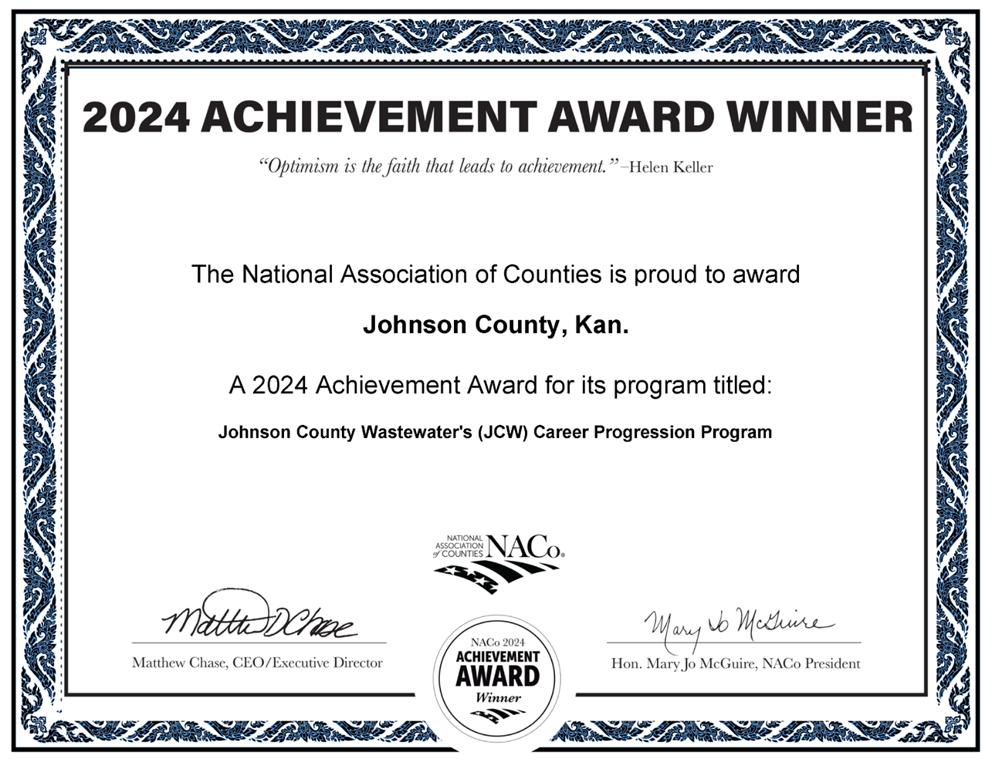

Slide 12
Question
What is 1 takeaway you can take back to organization?
Do you feel this was valuable information?

Slide 13

Questions and Feedback

