Slide 1

Affinis Industry Summit

Slide 2

Fast Facts – Kansas City Metro
The Kansas City metropolitan area continues to see healthy growth. In 2024, the metro added approximately 24,800 people — about a 1.11% increase.
On the Kansas side in particular, growth in Johnson County and neighboring municipalities positions Leawood in a very dynamic corridor.
Why this matters: population growth drives demand for housing, retail, services; competition is intensifying across suburbs.
Kansas Development Update

Slide 3
Fast Facts – Leawood
Population: 34,500 people (2024)
Median Household Income: $184,976 (2023)
Per Capita Income: About $108,619
Home Values/Housing: median home value of $620,400
Education: 75.1% hold a bachelor’s degree or higher
Poverty: 2.5% below the poverty line, much below regional averages
Kansas Development Update

Slide 4
Active Projects
Kansas Development Update

Slide 5
East Village of Leawood
East of Mission Road Near 133rd Street
Type: Residential & Mixed-Use neighborhood
Size: Upscale single-family homes, twin villas, and integrated green space
Key Details: Maintenance-provided homes with walkable amenities
Status: Phased build-out underway; units available and under construction
Kansas Development Update

Slide 6
Town Center Plaza & Crossing Redevelopment
119th Street and Nall Avenue
Type: Retail repositioning / potential mixed-use infill
Size: 550,000 sq. ft. across both properties
Key Details: Acquired by Federal Realty Investment Trust to redevelop and re-tenant existing centers
Kansas Development Update

Slide 7
Oxford Promenade
Southwest corner of 135th Street & Mission Road
Type: Mixed-use development
Size: Approximately 300 apartment units + retail and office space
Key Details: Designed as a walkable live-work-play node
Status: Project Timeline Extended
Kansas Development Update

Slide 8
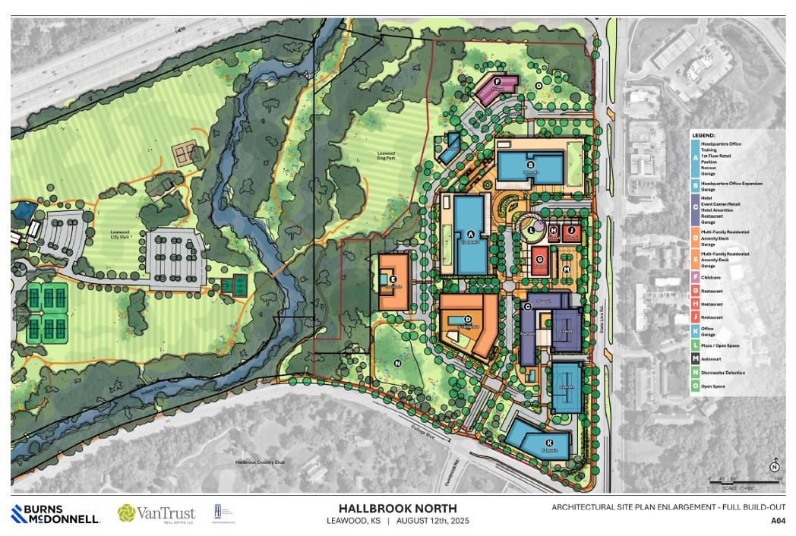
Hallbrook North
Mixed-Use Development at State Line Road & College Boulevard:
1,482,000 square feet over 32.4 acres
Eleven Buildings
Kansas Development Update

Slide 9
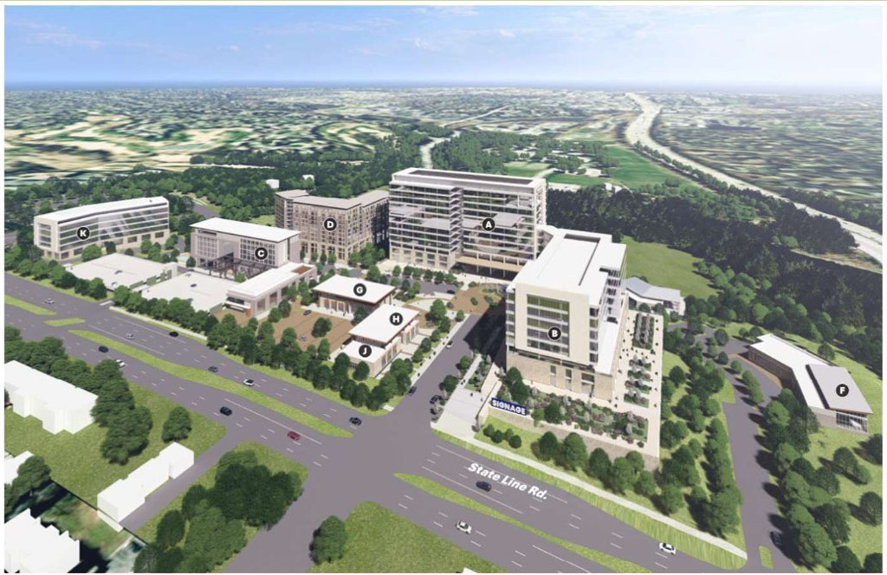
Hallbrook North
Includes:
857,000 sq. ft. of office space
65,000 sq. ft. hotel with 145 rooms
10,000 sq. ft. event center
499,000 sq. ft. of residential with 400 units
6,000 sq. ft. retreat center
14,000 sq. ft. daycare center
16,000 sq. ft. of retail; and
a ten-foot-wide trail connection to Leawood City Park
Kansas Development Update

Slide 10
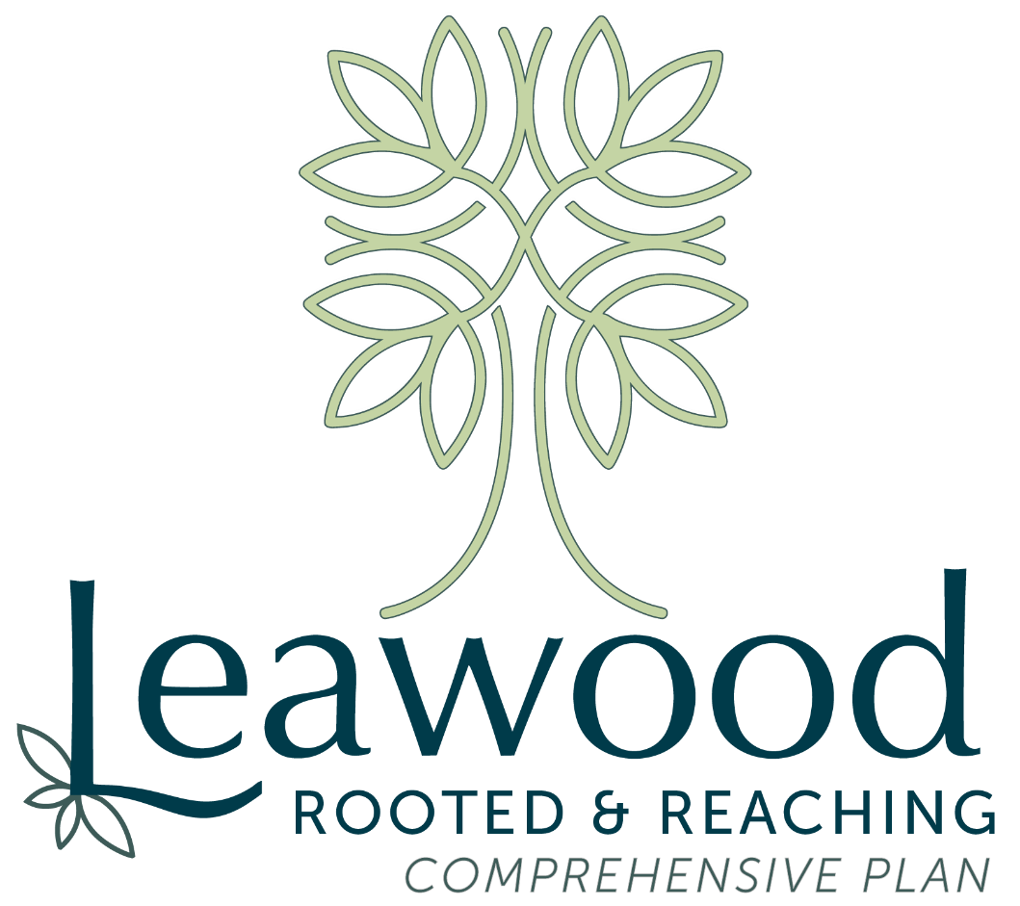
Kansas Development Update

Slide 11


Slide 12
Small Business Readiness Grant Program
Three-on-Three Recreational Soccer Tournament
Watch Party
Leawood World Cup

Slide 13
Questions?

